Slide 1



UNIT 6:
Around the world
Exploring the world

Slide 2
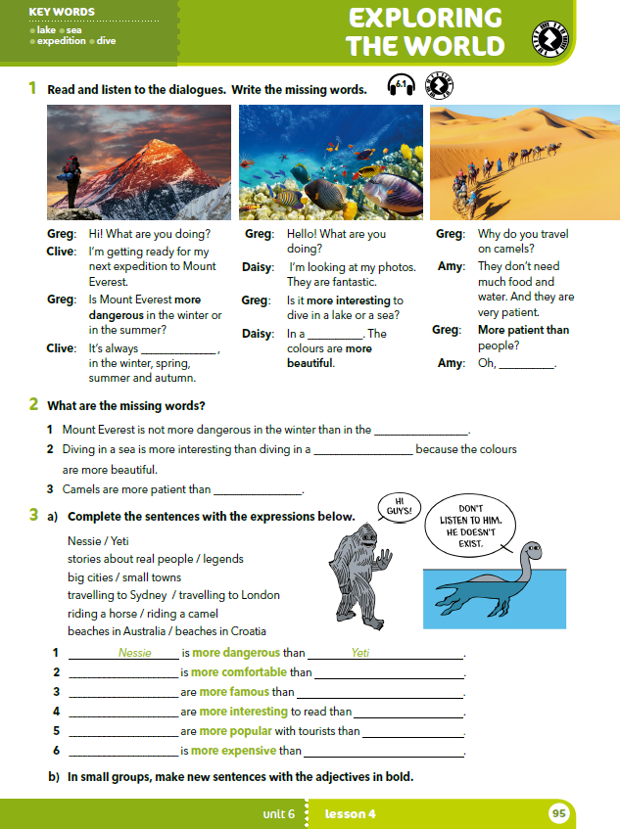
What living things can you see in the pictures?
What are they doing?
Where are they?

Slide 3
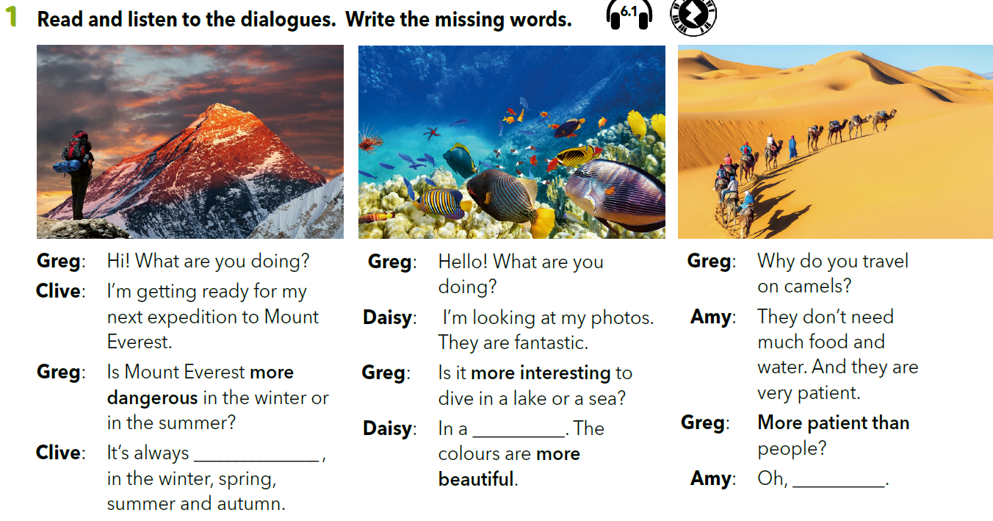
Who do you think Greg is? Is he in the photos?
Are Clive, Daisy and Amy in the photos?
Read the dialogue and check your answers.

Slide 4
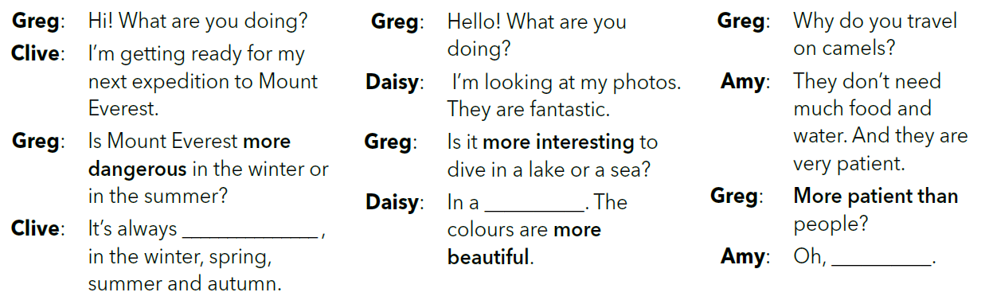

Look at the dialogues. Which words could you use to complete the sentences?
dangerous
Listen and complete the sentences.
https://www.e-sfera.hr/dodatni-digitalni-sadrzaji/b825980f-c02a-46f9-b98c-515f796fd6b6/assets/audio/42_unit_6_clive_4.mp3

Slide 5
Look at the dialogues. Which words could you use to complete the sentences?
sea
dangerous
https://www.e-sfera.hr/dodatni-digitalni-sadrzaji/b825980f-c02a-46f9-b98c-515f796fd6b6/assets/audio/43_unit_6_daisy.mp3
Listen and complete the sentences.

Slide 6
Look at the dialogues. Which words could you use to complete the sentences?
sea
dangerous
yes, they are
https://www.e-sfera.hr/dodatni-digitalni-sadrzaji/b825980f-c02a-46f9-b98c-515f796fd6b6/assets/audio/44_unit_6_amy.mp3
Listen and complete the sentences.

Slide 7
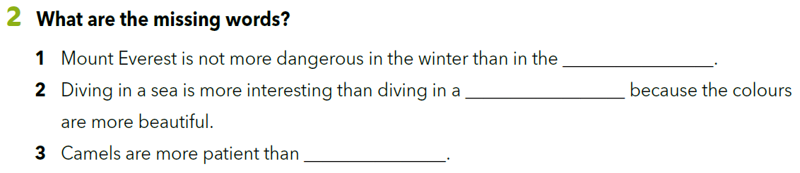
Complete the sentences with the missing words.
summer
lake
people

Slide 8
Look at the words in bold.
What type of words are dangerous, interesting, beautiful, patient?
They’re adjectives.

Slide 9
Look at the adjectives in the chart. What’s the difference?
long | dangerous
small | interesting
easy | beautiful
hot | patient
short adjectives
long adjectives

Slide 10
How do we form the comparative of short adjectives?
We add the suffix –er to the adjective.
small → smaller hot → hotter long → longer
How do we form the comparative of long adjectives?
We add ”more” before the adjective.
dangerous →
interesting →
more dangerous
more interesting
opasan → opasniji
zanimljiv → zanimljiviji

Slide 11
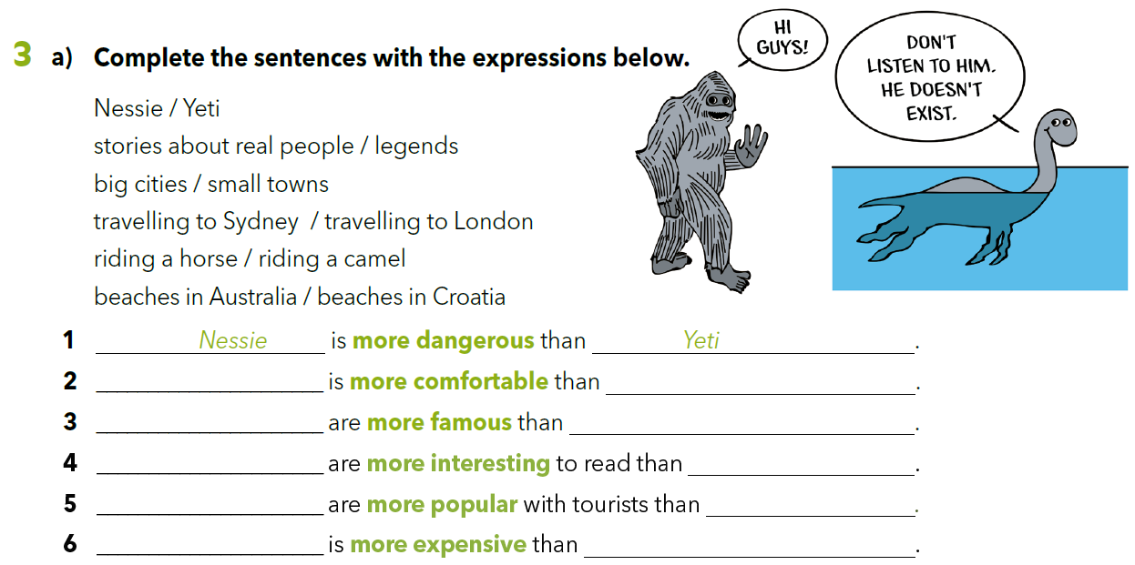
Who is Nessie?
Why is Nessie more dangerous than Yeti?
Who is Yeti?

Slide 12
Riding a horse
riding a camel.
Beaches in Australia
beaches in Croatia
Stories about real people
legends
Big cities
small towns
Travelling to Sydney
travelling to London

Slide 13
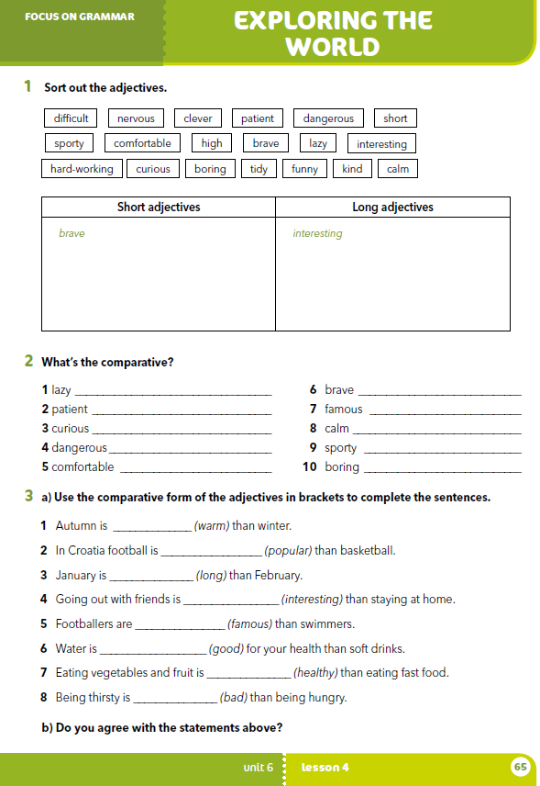
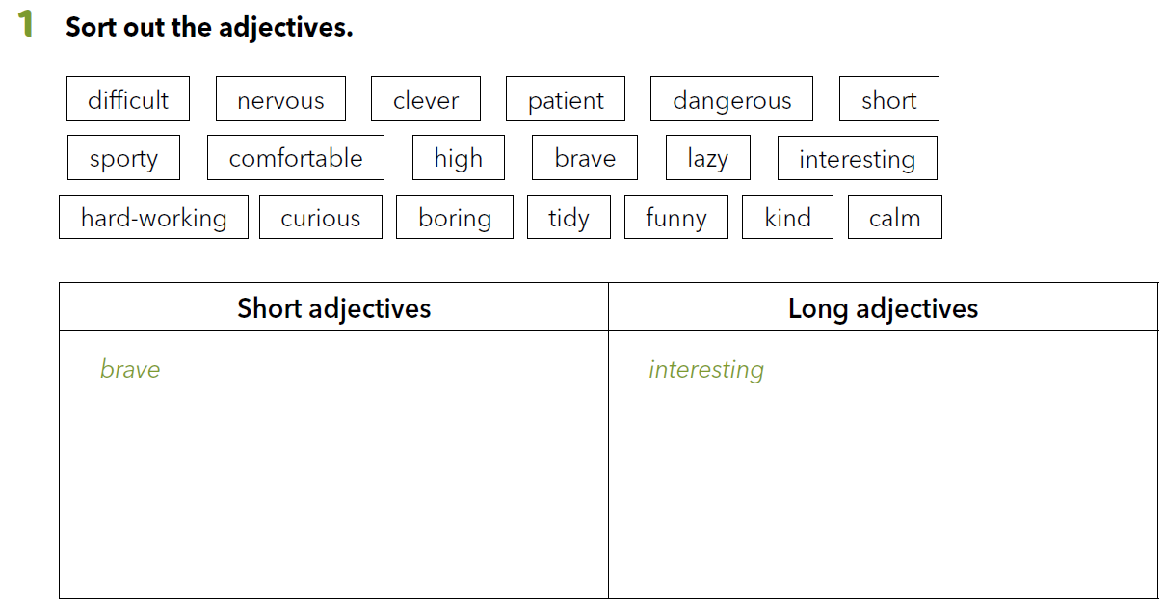
Workbook p. 65
short sporty high
lazy tidy funny kind calm
difficult nervous
patient dangerous comfortable hard-working
curious boring

Slide 14
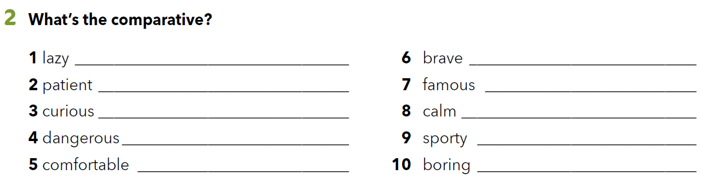
lazier
braver
more patient
more famous
more curious
calmer
more dangerous
sportier
more comfortable
more boring

Slide 15
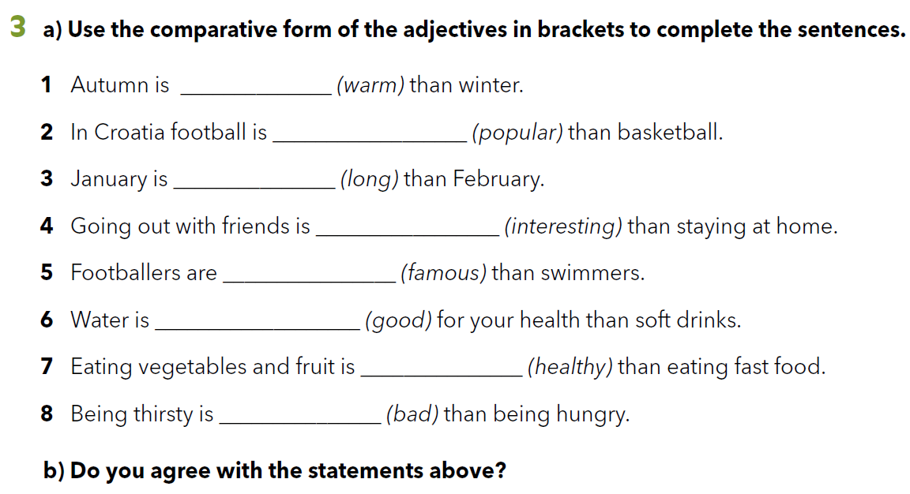
warmer
more popular
longer
more interesting
more famous
better
healthier
worse

Slide 16
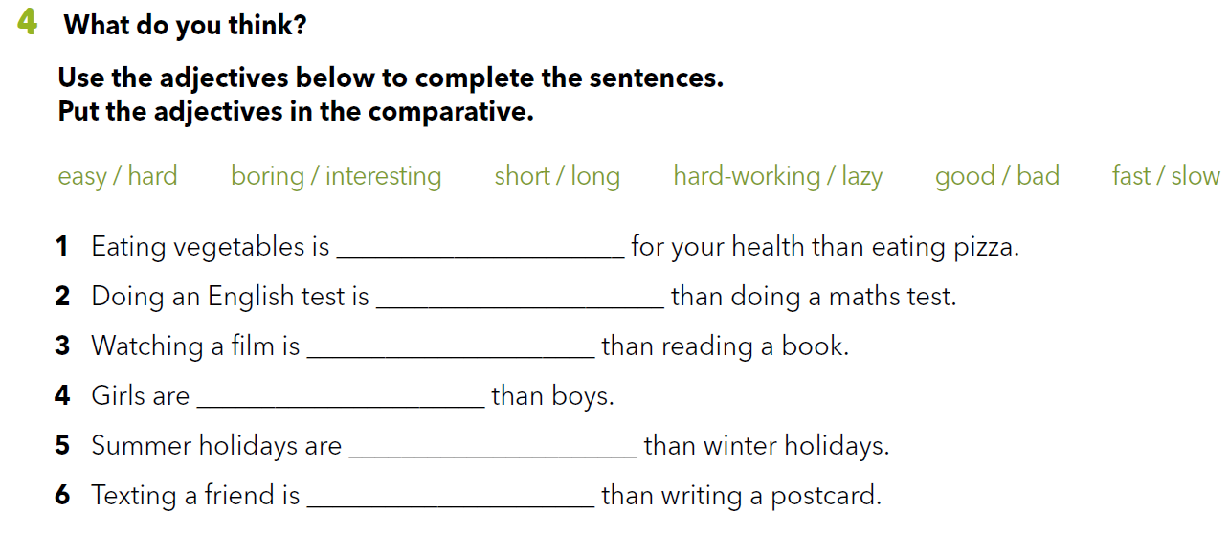

Slide 17
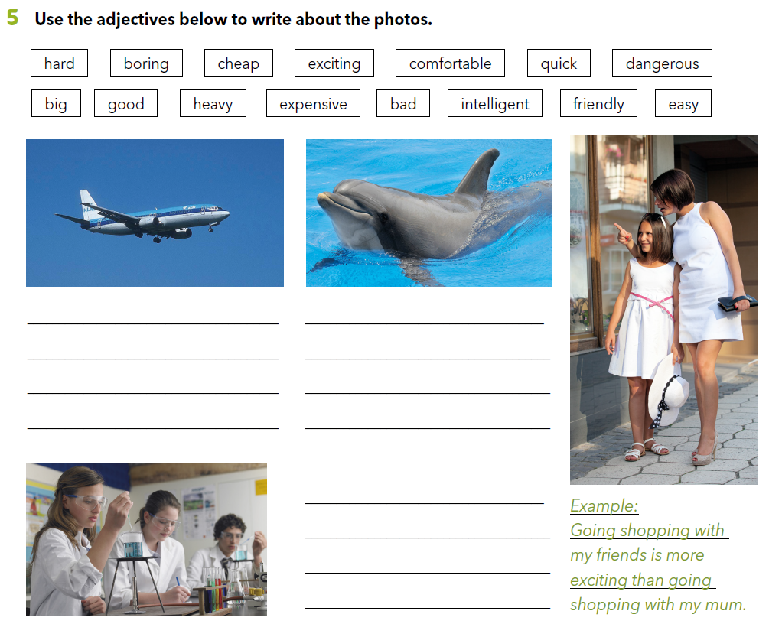
*Flying in a plane is faster than driving in a car.
*Dolphins are more friendly than whales.
* Possible answers.
*Science is more exciting than maths.

Slide 18

LET’S REVISE!
PLAY AND LEARN
https://learningapps.org/watch?v=p99t15uk518
SELF CHECK.
https://www.e-sfera.hr/dodatni-digitalni-sadrzaji/b825980f-c02a-46f9-b98c-515f796fd6b6/

Slide 19
LEARN MORE.
https://www.e-sfera.hr/dodatni-digitalni-sadrzaji/b825980f-c02a-46f9-b98c-515f796fd6b6/
Mysterious creatures

